Slide 1

John’s little pinky promise quiz
Second lockdown special

Slide 2
Round 1
Multi Choice

Slide 3
Question 1
10% of Americans think it is acceptable to start drinking at what time.
10 AM or earlier
noon or earlier
2pm or later
6pm or later

Slide 4
Question 2
Pteronophobia is the fear of what;
Flying lizards
Canada
Feathers
The dark

Slide 5
Question 3
More than what percentage of the world's population consumes caffeine on a daily basis.
30%
50%
70%
90%

Slide 6
Question 4
New Zealand has the ability to block certain baby names if they’re considered offensive. Which one of these is a rejected name?
Violence
Number 16 Bus Shelter
Twins called Fish and Chips
Twins called Benson and Hedges

Slide 7
Question 5
In 1995, Tuvalu was assigned the domain code .tv. Tuvalu now earns about what fraction of its annual gross national income by licensing .tv to tech companies.
1/24th
1/12th
1/9th
1/4th

Slide 8
Question 6
A Russian book on etiquette from 1889 suggested that women should avoid what?
Shouting
Talking to your neighbours husband
Unpleasant language
Puns

Slide 9
Question 7
Which primates have the largest average size of penises.
Gorilla
Human
Orangutan
Chimpanzee

Slide 10
Question 8
Which of these is an acronym
Wtf
Fyi
Lol
Lmfao

Slide 11
Question 9
If you received x dollars for every year that the universe has existed, you would have approximately as much money as Jeff Bezos.
$1
$10
$100
$1000

Slide 12
Question 10
The first sport to resume after the UK’s Coronavirus lockdown was eased was;
competitive pigeon racing
golf
tennis
snooker

Slide 13
Round 2
True or False

Slide 14
Question 11
True or False?
In Texas it is illegal to change the weather

Slide 15
Question 12
True or False?
In the USA it is illegal for more and 2 people to gather in public wearing masks.

Slide 16
Question 13
True or False?
There is an ancient Egyptian frieze in The Temple of Seti that appears to show a helicopter, an aeroplane and a submarine

Slide 17
Question 14
True or False?
The average person walks past 5 murderers in their life.

Slide 18
Question 15
True or False?
Humans glow in the dark

Slide 19
Question 16
True or False?
The American state of New Hampshire has legalised flying cars

Slide 20
Question 17
True or False?
The Swedish word GÖKOTTA means to wake up early in the morning in order to go outside and hear the first birds sing

Slide 21
Question 18
True or False?
Among the Yoruba-speaking population of Nigeria, “Man United” is slang for “idiot”.

Slide 22
Question 19
True or False?
Every Dutch police car is equipped with a teddy bear to give children that are scared

Slide 23
Question 20
True or False?
It is illegal to own a rabbit in Queensland, Australia unless you can prove you are a practicing magician.

Slide 24
Round 3
Short break?
Mics

Slide 25
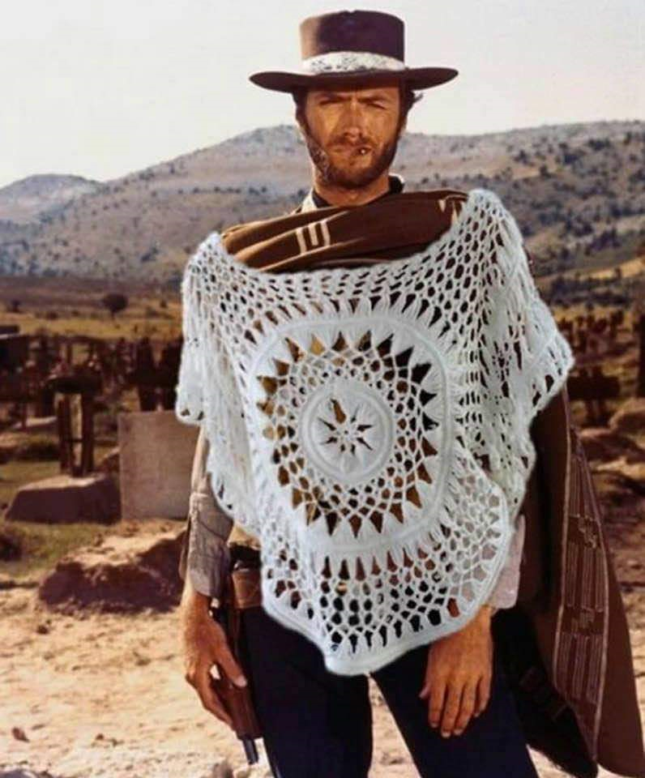
Question 21
Name the film
(say what you see)

Slide 26
Question 22
Monks in the Khun Han district of Thailand were frustrated with littering in their district, so they did what?

Slide 27
Question 23
Lloyds Bank Coprolite was left behind by the Vikings. It was found in York where a branch of Lloyds Bank now stands. What is it?

Slide 28
Question 24
Dr Seuss' publisher bet $50 that him he could not write a book using only 50 words. Did he win the bet?

Slide 29
Question 25
HOFSTADTER'S LAW states that "a task always takes longer than you expect, even when you take into account …“ What?

Slide 30
Question 26
What music album was so popular in Poland that the nation exhausted its entire supply of foreign currency buying it?
I can give a clue of the year.

Slide 31
Question 27
What does it mean to be stereoblind?

Slide 32
Question 28
The Icelandic word ‘vasa’ means pocket.
What famous 1980’s product was given the Icelandic name ‘vasadiskó’.

Slide 33
Question 29
Name something often found in the bottom of bird cages _ _ IT

Slide 34
Question 30
What's red and smells and is often picked in the garden _ OSE

Slide 35
Round 4
Any other business

Slide 36
Question 31
True False,
Before taking office in Kentucky, all politicians must swear that they have never been in a gun fight

Slide 37
Question 32
What part of a car, has been engineered using psychoacoustics to sound much more robust than it actually is.
Engine
Breaks
Door
Trunk (the boot in England)

Slide 38
Question 33
What is the most popular “trade name” surname across Europe.

Slide 39
Question 34
How many species of shark that can walk across land?
None
One
Five
Nine

Slide 40
Question 35
True or False
People who reflexively sneeze if a bright light is shone in their eyes have ACHOO syndrome.

Slide 41
Question 36
The word ‘good-bye’ comes from the 16th-century word ‘godbwye’, which literally means what?

Slide 42
Question 37
In ‘The Art of Farting’ (1751), Pierre-Thomas Hurtault gave a classification of farts that included 3 of the following. Which one is false
Silent but smelly
Soft and sudden
Bourgeois women
Geographers

Slide 43
Question 38
True or false,
The Beatles wanted to make a Lord of the Rings film with John Lennon as Golum.

Slide 44
Question 39
When a tattoo is laser-removed, what happens to the ink?

Slide 45
Question 40
How long was the world’s longest recorded fart?
(Nearest answer wins)

Slide 46
Time for a break
That’s the end of the quiz

